Slide 1

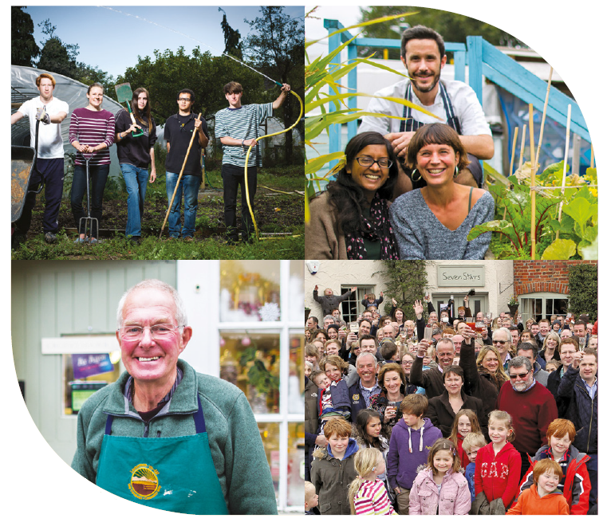
Employing young people in a community business
What you need to know

Slide 2

Your responsibility as an employer
When employing a young person under the age of 18, whether for work, work experience overview, or as an apprentice, employers have the same responsibilities for their health, safety and welfare as they do for other employees.
HMRC

Slide 3

What is 'Employment'?
A child is employed if (s)he assists in any trade or occupation carried on for profit whether or not the child receives pay or reward.
It also applies whether or not the parent is the employer.

Slide 4
Definitions of young people and children by age:
A young person is anyone under 18.
A child is anyone who has not yet reached the official minimum school leaving age (MSLA). Pupils will reach the MSLA in the school year in which they turn 16.
https://www.hse.gov.uk/youngpeople/index.htm

Slide 5
The Law
Says: No one under 13 years old may be employed
Restricts: the type of job and hours
Makes: the employer responsible

Slide 6
Young people are entitled to:
a 1 hour break after 4 hours; a safe working environment;
2 weeks holiday (unpaid).
Young people's rights
However, they have no right to a minimum wage, sick pay or pension.

Slide 7
Working hours restrictions
Young people are restricted to working:
2 hours on a school day;
5 hours on a Saturday;
2 hours on a Sunday;
and
12 hours a week in school term-time and
25 hours a week in school holidays.
If under 16, young people cannot be employed before 7am or after 7pm without a special license (e.g. farming).

Slide 8
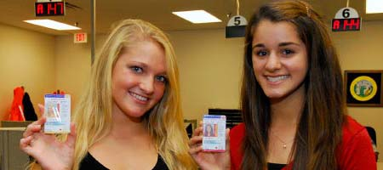
Young people need:
A work permit
Until the end of Year 11 in school (yes, even volunteers)

Slide 9
Work permits
The council is responsible for work permits
They differ slightly from council to council
Parental signature is required
The young person's school is informed

Slide 10
Work permit application form example

Slide 11
Why do young people volunteer?
The primary motivations for volunteering for the 16-­25 age group are:
• To gain work experience (83%)
• To gain or improve skills (78%)
• To help other people (75%)
• To learn new things (71%)
• To do something positive (64%)
So stress these benefits if you want to encourage local young people to work with you!

Slide 12
Factors related to getting a job
Employment
  “[Experience is] what employers actually look for nowadays, they don’t actually look for qualifications any more”
  Neil, 18, Birmingham

Slide 13
What else might encourage a young person to get involved?
Flexibility – of hours, type of work and commitment
Legitimacy – it needs to be worthwhile and useful
Make it easy to start - many young people simply don’t know how to start, or who to contact
Offer real work experience - young people want relevant, useful experience and to learn new skills
Spell out the benefits – what’s in it for them? E.g skills, experience to add to a CV
Your business culture – volunteering needs to be both well organised, and informal
Laughs – it needs to be fun!

Slide 14

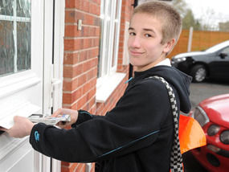


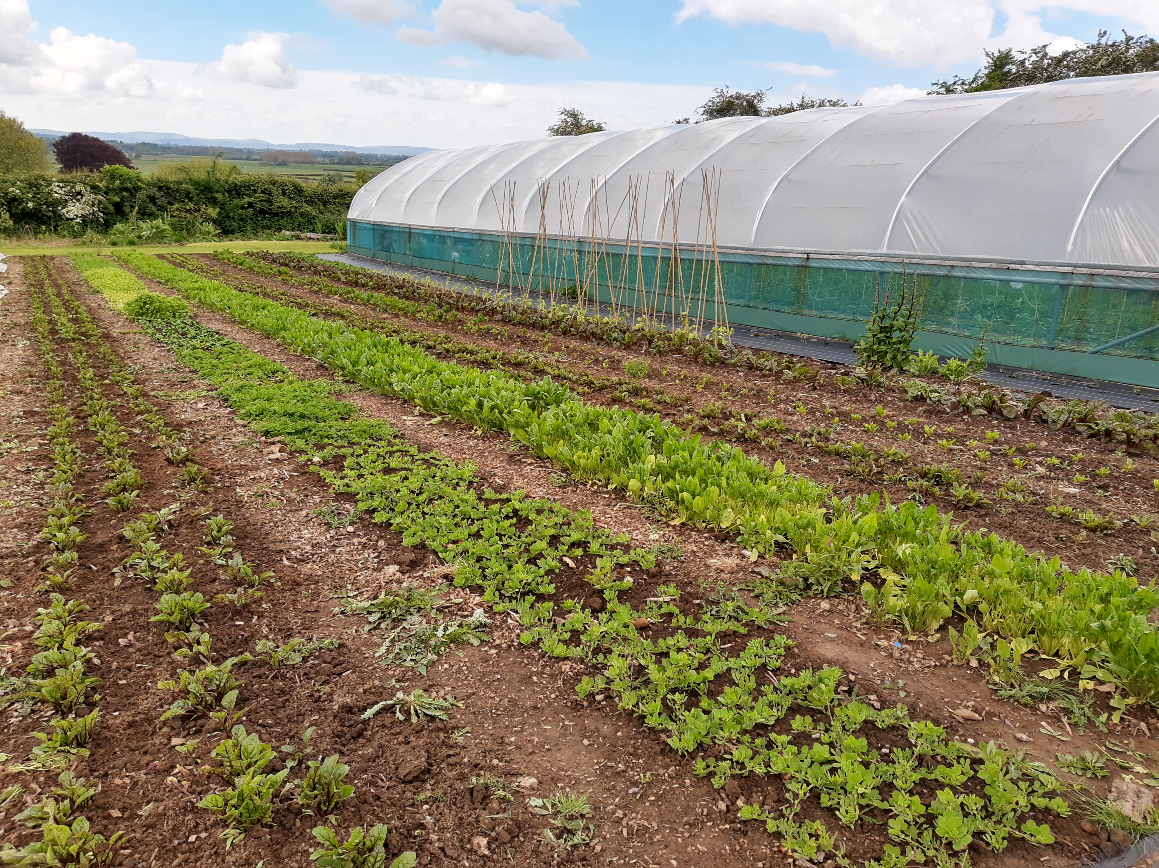
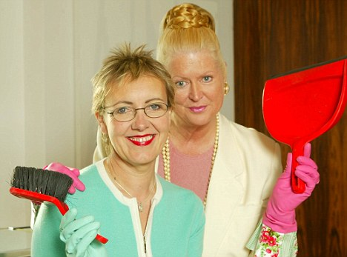
What could young people do?
Deliveries
Back office work
Waiting / serving / events
Social media / website work
Outdoors: growing food, planting up pots, gardening
Cleaning / tidying / pot washing / painting

Slide 15




Benefits of part time work
Money
Social Skills
Experience
Getting a Reference

Slide 16
Work experience develops personal skills, confidence and more opportunities
“Before I started my first job, I couldn’t talk to anyone, and after having a part-time job for about nearly two years, I could come into a place like this and talk to absolutely anyone, get on with them and know what to do basically.”
Brett, 22, Birmingham
“I think it’s hard because no one wants to employ someone’s who’s got no experience, then no one will employ them to get the experience and then they can’t get a job.”
Kema, 17, Leicester

Slide 17
Barriers to volunteering for young people
People forgetting that young people are individuals, not alike in personality, interests, confidence or abilities.
Lack of time: school, clubs or caring responsibilities
Feeling they would have to make too big a commitment
Lack of interest
No-one asked them!
Don’t know what they’ll gain from it
Don’t feel needed
Lack of transportation/support
Being self-conscious and under-confident

Slide 18

Role descriptions – what to include
Explain what the minimum and maximum commitment is (hours / timeframe)
Be clear about what they will be required to do
What the benefits to them personally will be
Give examples of how their contribution will help their local community e.g. what you know it means to vulnerable or isolated local people
What training and support they will receive.

Slide 19
Sample role description

Slide 20
Use the right words
Use active, positive, empowering language to advertise roles in your community business:
"Sign up, get involved, take action, help directly, stand out, step forward, speak up, take this chance, opportunity, grab some experience, make a difference, campaign, support people around you, be part of the business we all own."

Slide 21
What you can do to retain young people in your business
SO: make sure other employees are compatible and happy with working alongside a young person, smile and laugh, be kind, explain and train from scratch, reassure, check and check again that they are OK, ask if there are any problems, give permission to say something isn't right or they don’t like doing it and SAY THANK YOU EVERY TIME!

Slide 22
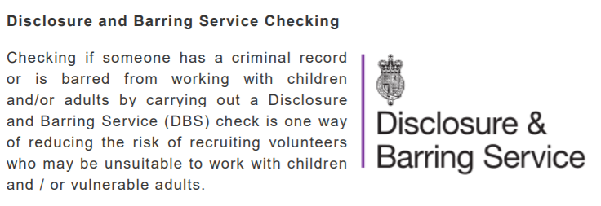
DBS Checks
Notes:
Having mentioned screening on the previous slide - just a note about DBS because
I’m often asked about DBS (by community shops in particular and charity shops)
Just to clarify …
Anyone working in retail, e.g. charity shops, can apply for a Basic Disclosure Check – regardless of whether they are working with children or not. Whether organisations can apply for Standard or Enhanced Disclosure Checks also depend on who your volunteers are working with, what activities they’re doing and how often they are carrying out those activities

Slide 23
(DBS) Disclosure and Barring Checks
Guidance is available on the following website www.gov.uk/government/collections/dbs-eligibility-guidance
The eligibility tool and workforce guides will help you to decide whether a role is eligible, and if so, which level of DBS check is suitable.
Notes:
Whilst it is a useful tool in helping to identify unsuitable volunteers, it is not enough just to rely on carrying out a DBS check and this should be used as part of a recruitment process which involves interviews, references and ongoing training and supervision once the volunteer has started in their role.
The duty of care requires that an organisation does everything reasonable within its power to protect people from harm. It could be argued that if an organisation works with children and / or vulnerable adults, part of this duty of care is to undertake DBS checks on volunteers who are going to work with those people.

Slide 24
Risk Assessment and
Young People
For employees under the age of 18, risk assessments should consider:
Inexperience, lack of awareness, immaturity
Fitting and layout of workplace
Nature, degree and duration of exposure
to agents
Work equipment
Organisation of work
Training provided

Slide 25
Risk Assessment Process

Slide 26
Risk Assessment Sample

Slide 27
Risk Assessment Sample
Action No. | Description _ What are the Hazards | Who Might Be Harmed & How | Existing Control Measures | Additional Control Measures / Actions | Risk (consequence x Likelihood) | Risk Level
1 | General Slips Trips & Falls Manual Handling Fire safety | Young Person Other Staff Customers | Staff training Staff Handbook Organisation policies |  | 4 X 3 =12 | LOW
2 | Lone Working Risk of burglary /violence | Young Person Other Staff Customers | Staff training Staff Handbook Organisation policies Security camera Panic Alarm Supervision by member of staff | UNDER NO CIRCUMSTANCES SHOULD A YOUNG PERSON BE LEFT ALONE on the PREMISES | 4 X 3 =12 | LOW
3 | Alcohol and Tobacco sales Inappropriate sale of alcohol or cigarettes by a minor | Young Person Other Staff Customers | Staff training Staff Handbook Organisation policies Supervision by member of | UNDER NO CIRCUMSTANCES SHOULD A YOUNG PERSON BE LEFT ALONE on the PREMISES | 3 X 2 = 6 | LOW

Slide 28
Job Checklist Sample

