Slide 1
What legal forms are
best suited to community businesses?
Supporting rural
community-owned
businesses
Nick Comley
Community Business Adviser

Slide 2
Incorporated Legal Forms
Able to enter into contracts and to trade
Limited liability for Trustees/Directors members by guarantee or shares
Can own assets and borrow money
Can employ people

Slide 3
Regulators
Companies House and CIC Regulator
(Companies Act 2006 and Community Interest Companies Regulations 2005)
Financial Conduct Authority
(Co-operative and Community Benefit Societies Act 2014)
Charity Commission in England and Wales/OSCR/NI
(Charities Act 2011/ Charities (Regulation and Administration) (Scotland) Act 2023)
HMRC Community Amateur Sports Clubs
(The Community Amateur Sports Clubs Regulations 2015)

Slide 4
Companies House
Public Limited Companies
Private Limited Companies – by guarantee or shares
Community Interest Companies – by guarantee or shares
Limited Liability Partnerships

Slide 5
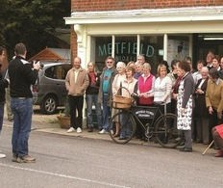
CIC Regulator
CIC Public Limited Company
CIC Private Company Limited by
Guarantee Small/Large Membership
CIC Private Company Limited by Withdrawable and Transferable Shares with Distribution Rights

Slide 6
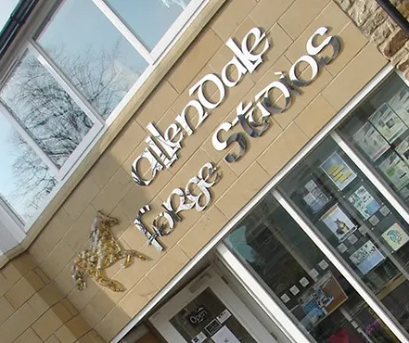
Community Business CIC
CIC Private Company Limited by Guarantee Large Membership
Memorandum and Articles of
Association
Asset lock
Public Benefit Threshold
CIC 37 Annual Return

Slide 7
Financial Conduct Authority
Co-operative Societies:
Co-operative Principles
Member owned
Democratic or sociocratic decision making
Limited by shares
Profit distribution allowed

Slide 8
Financial Conduct Authority
Community Benefit Societies:
Member owned
Asset lock
Public benefit
Limited by Exempt Community Shares
No distribution of profits
Can be Exempt Charity with HMRC

Slide 9
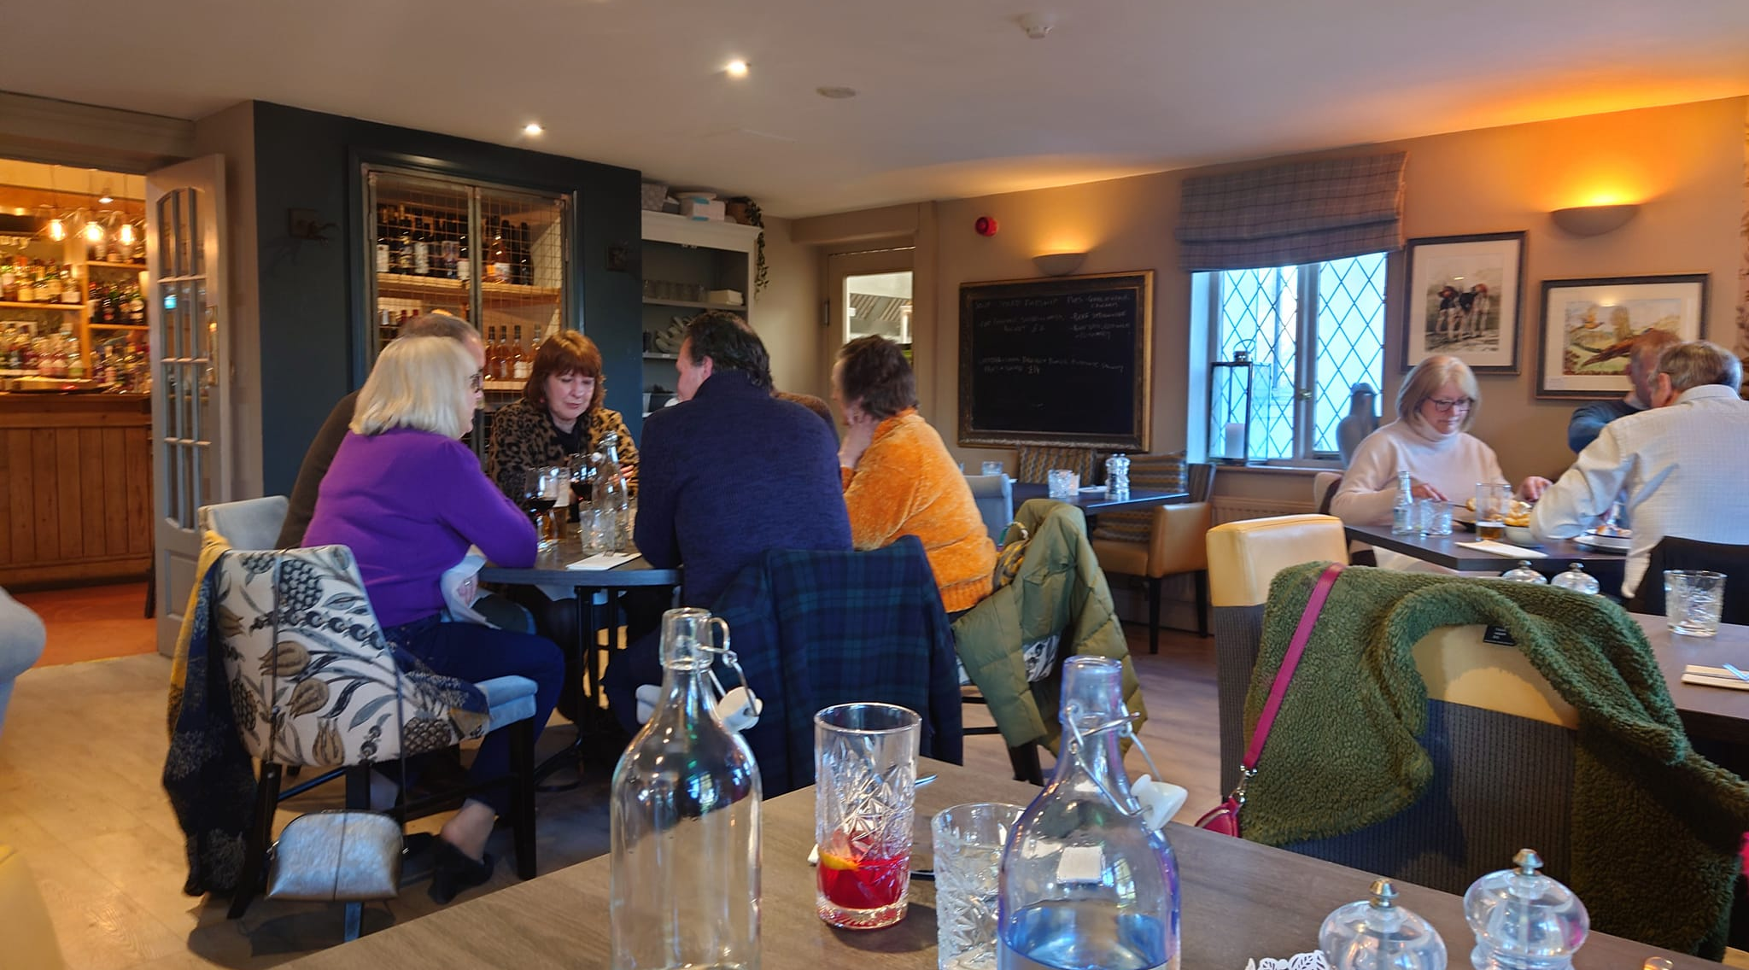
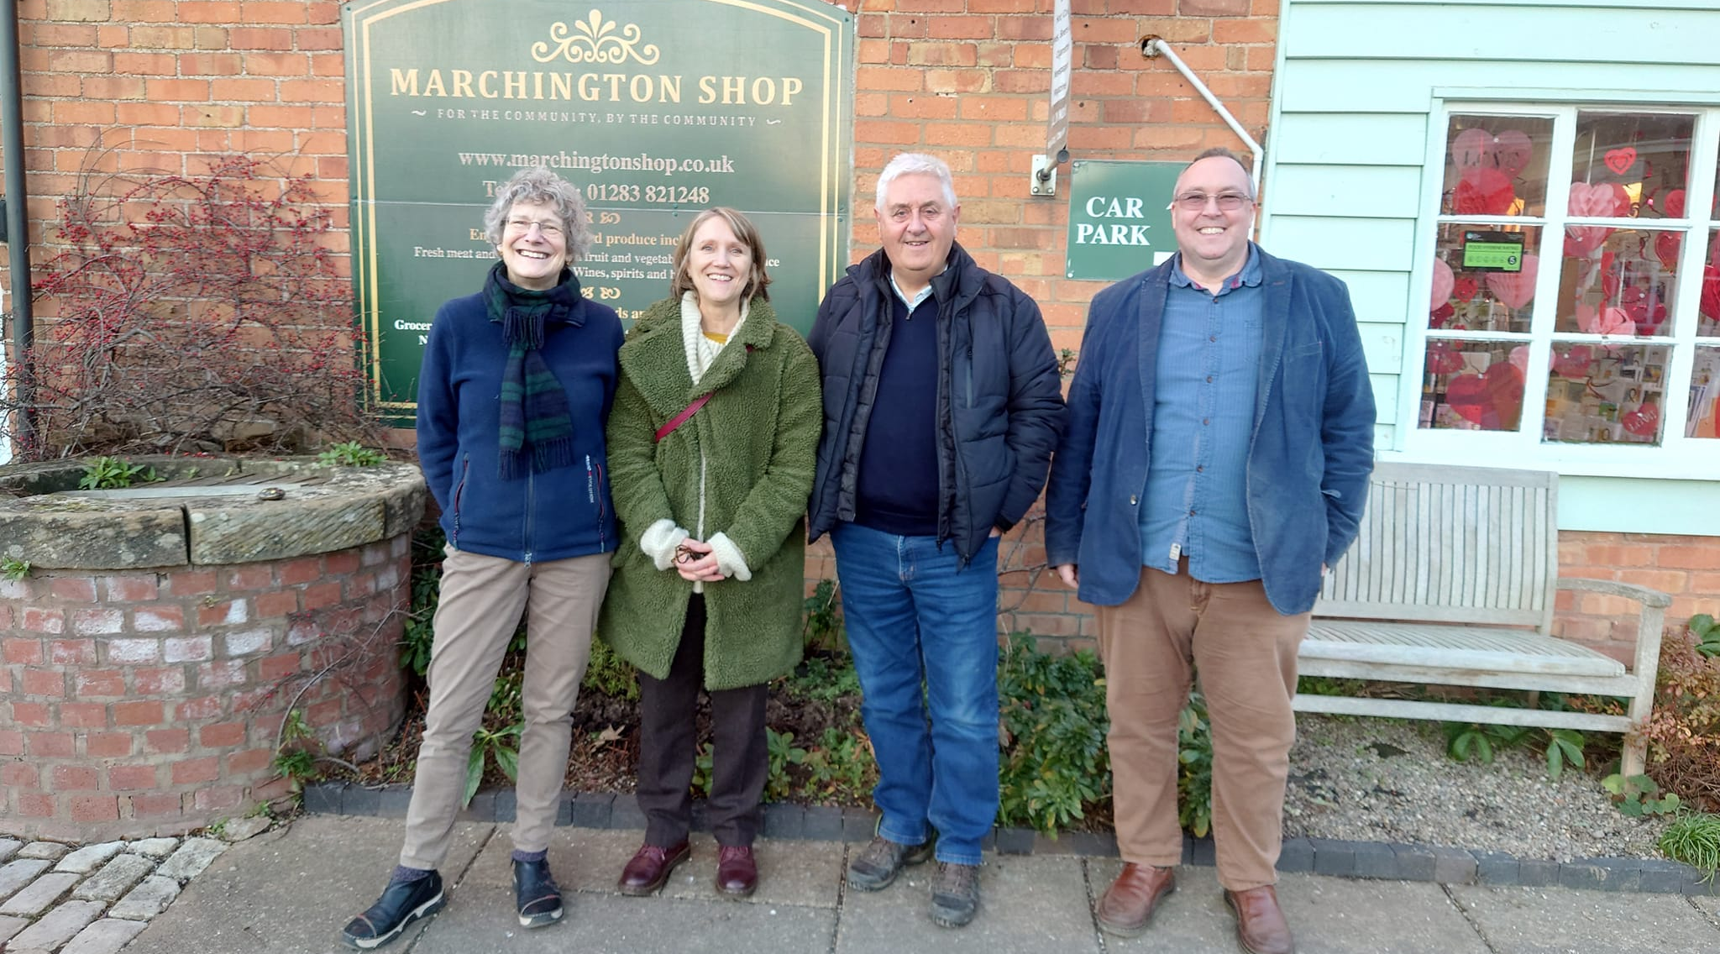
Community Benefit Society
Sponsoring organisation to register with FCA using pre-approved ‘Model Rules’
Primary trading for the benefit of the community not personal gain
Rules not Mem and Arts

Slide 10
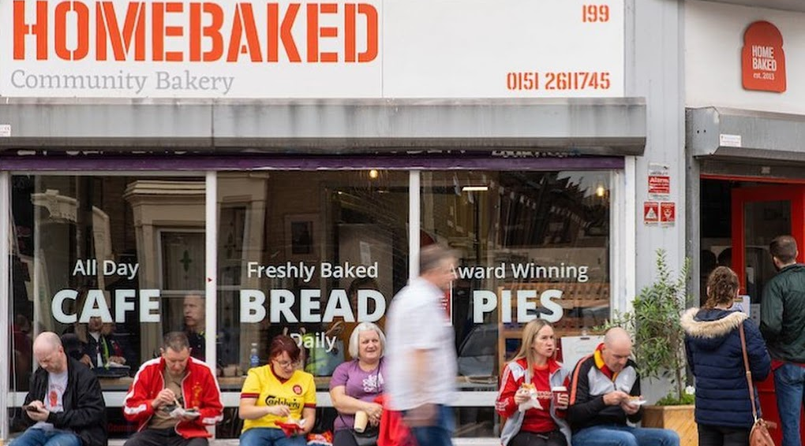
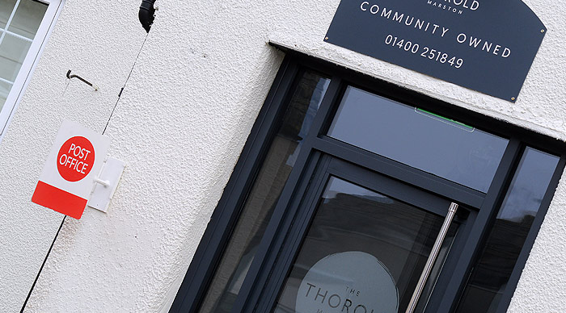
Community Benefit Society
Democratically run – One Member,
One Vote
Interest bearing Withdrawable Exempt Community Shares
Limited liability to value of
shareholding
Asset Lock

Slide 11
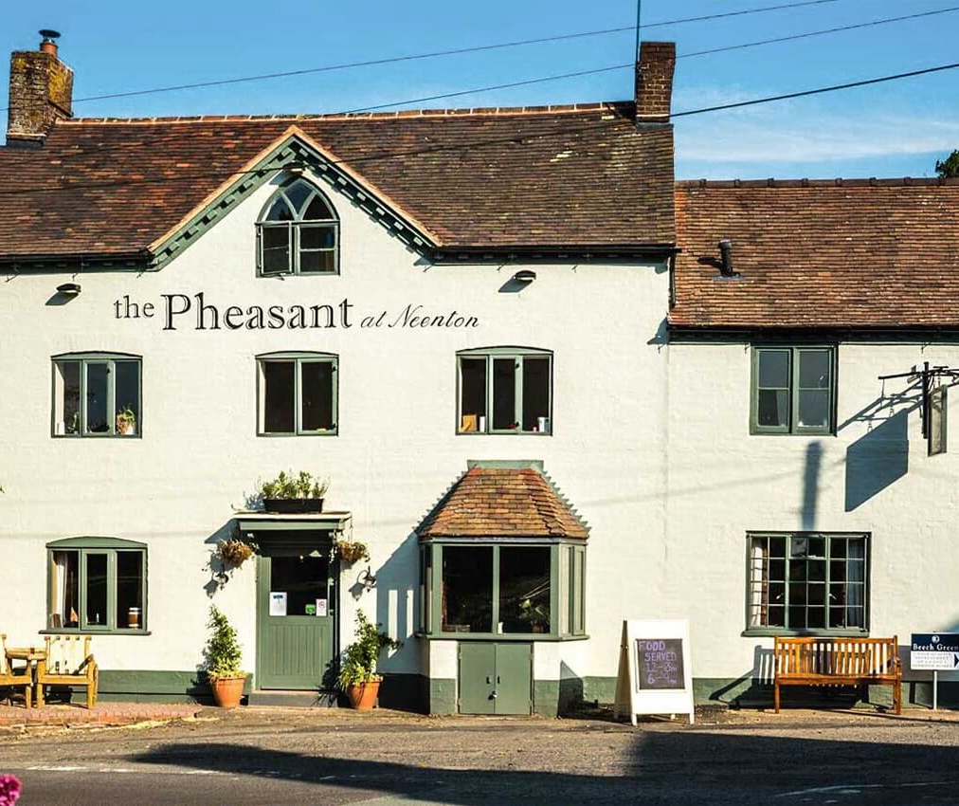
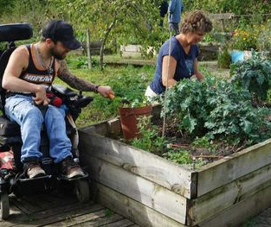
Charitable Community Benefit Society
Registered and regulated by the
Financial Conduct Authority and
HMRC as Charitable for Tax Purposes
Primary purpose charitable trading
Rules not Mem and Arts
Democratically run – One Member,
One Vote

Slide 12
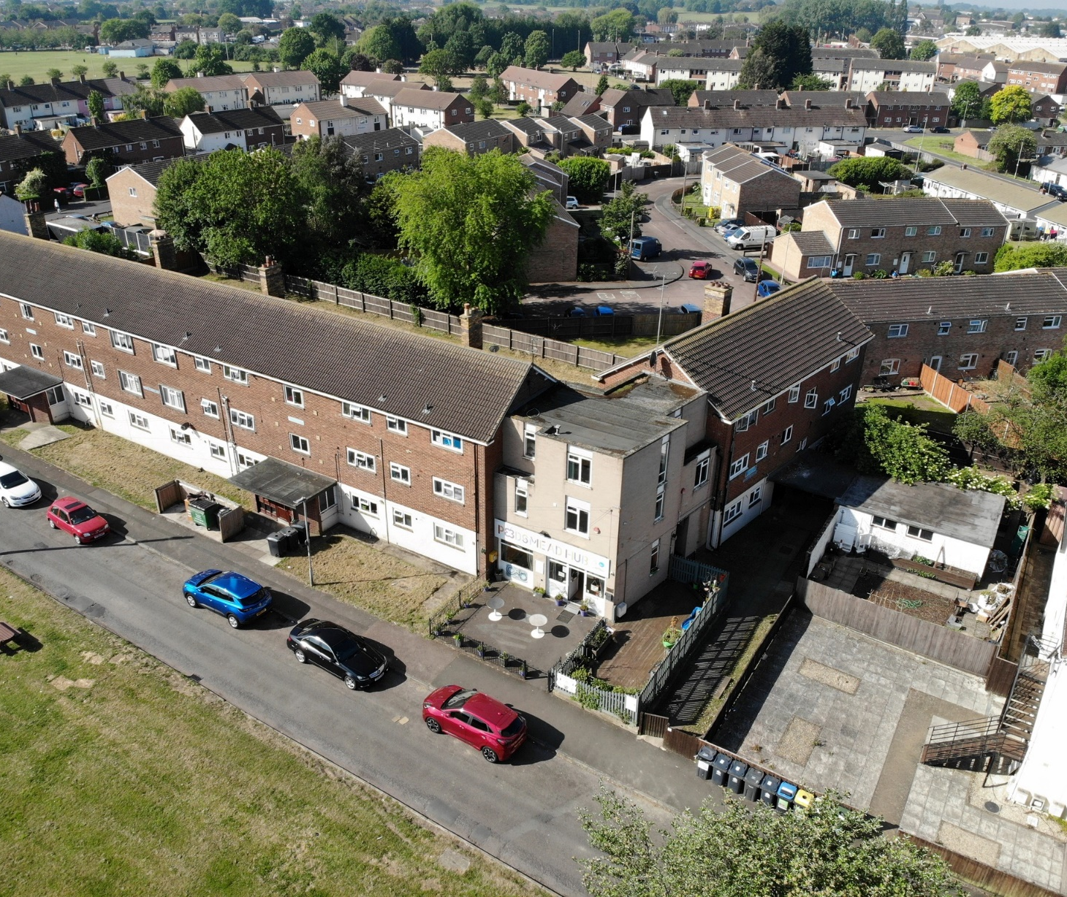
Charitable Community Benefit Society
Interest bearing Withdrawable Exempt Community Shares
Limited liability to value of
shareholding
Eligible for most grants and tax
reliefs like Gift Aid

Slide 13
Charity Commissions for:
England and Wales
Northern Ireland
Scotland

Slide 14
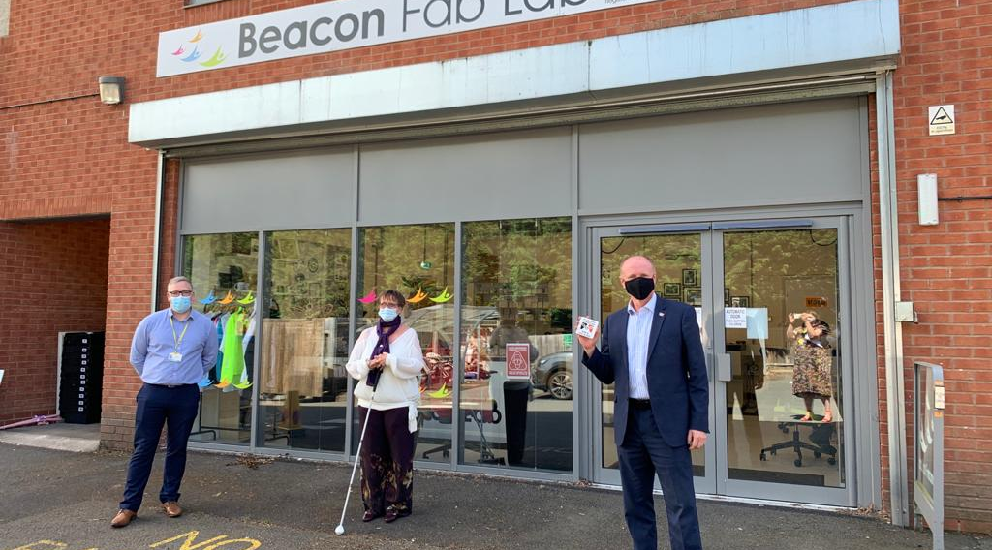
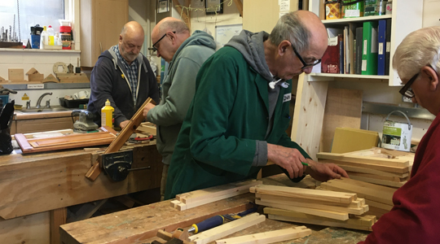
Charities
Charitable Trust or Foundation
Charitable Company Limited by Guarantee or Shares
Charitable Incorporated
Organisations

Slide 15
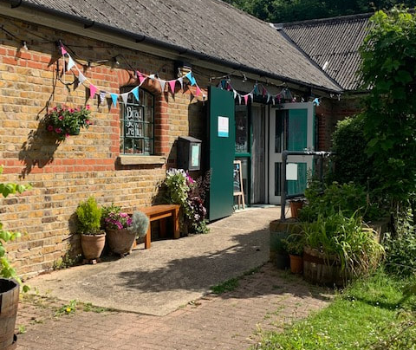
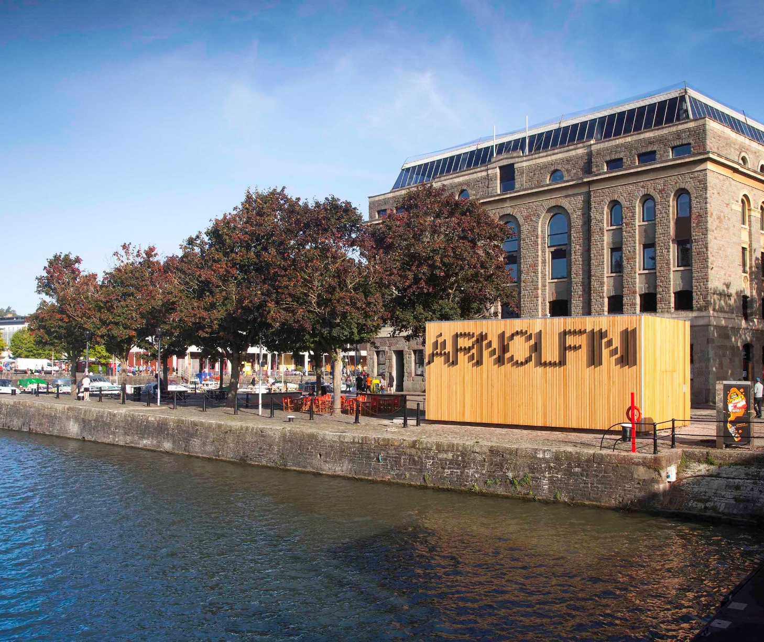
Charitable Incorporated Organisations
Two types of Constitutions:
Foundation Model
Association Model

Slide 16
Charitable Incorporated Organisations
Foundation – Trustees are the only members
Association – Larger membership with elected
Board of Trustees
Primary purpose charitable trading for public benefit
Limited Liability by Guarantee

Slide 17
Community Amateur Sports Club
(CASC)
Registered with HMRC and may need a trading arm subsidiary to operate retail or hospitality services
To register as a new CASC you must be based in the UK, provide facilities for eligible sports and encourage people to take part

Slide 18
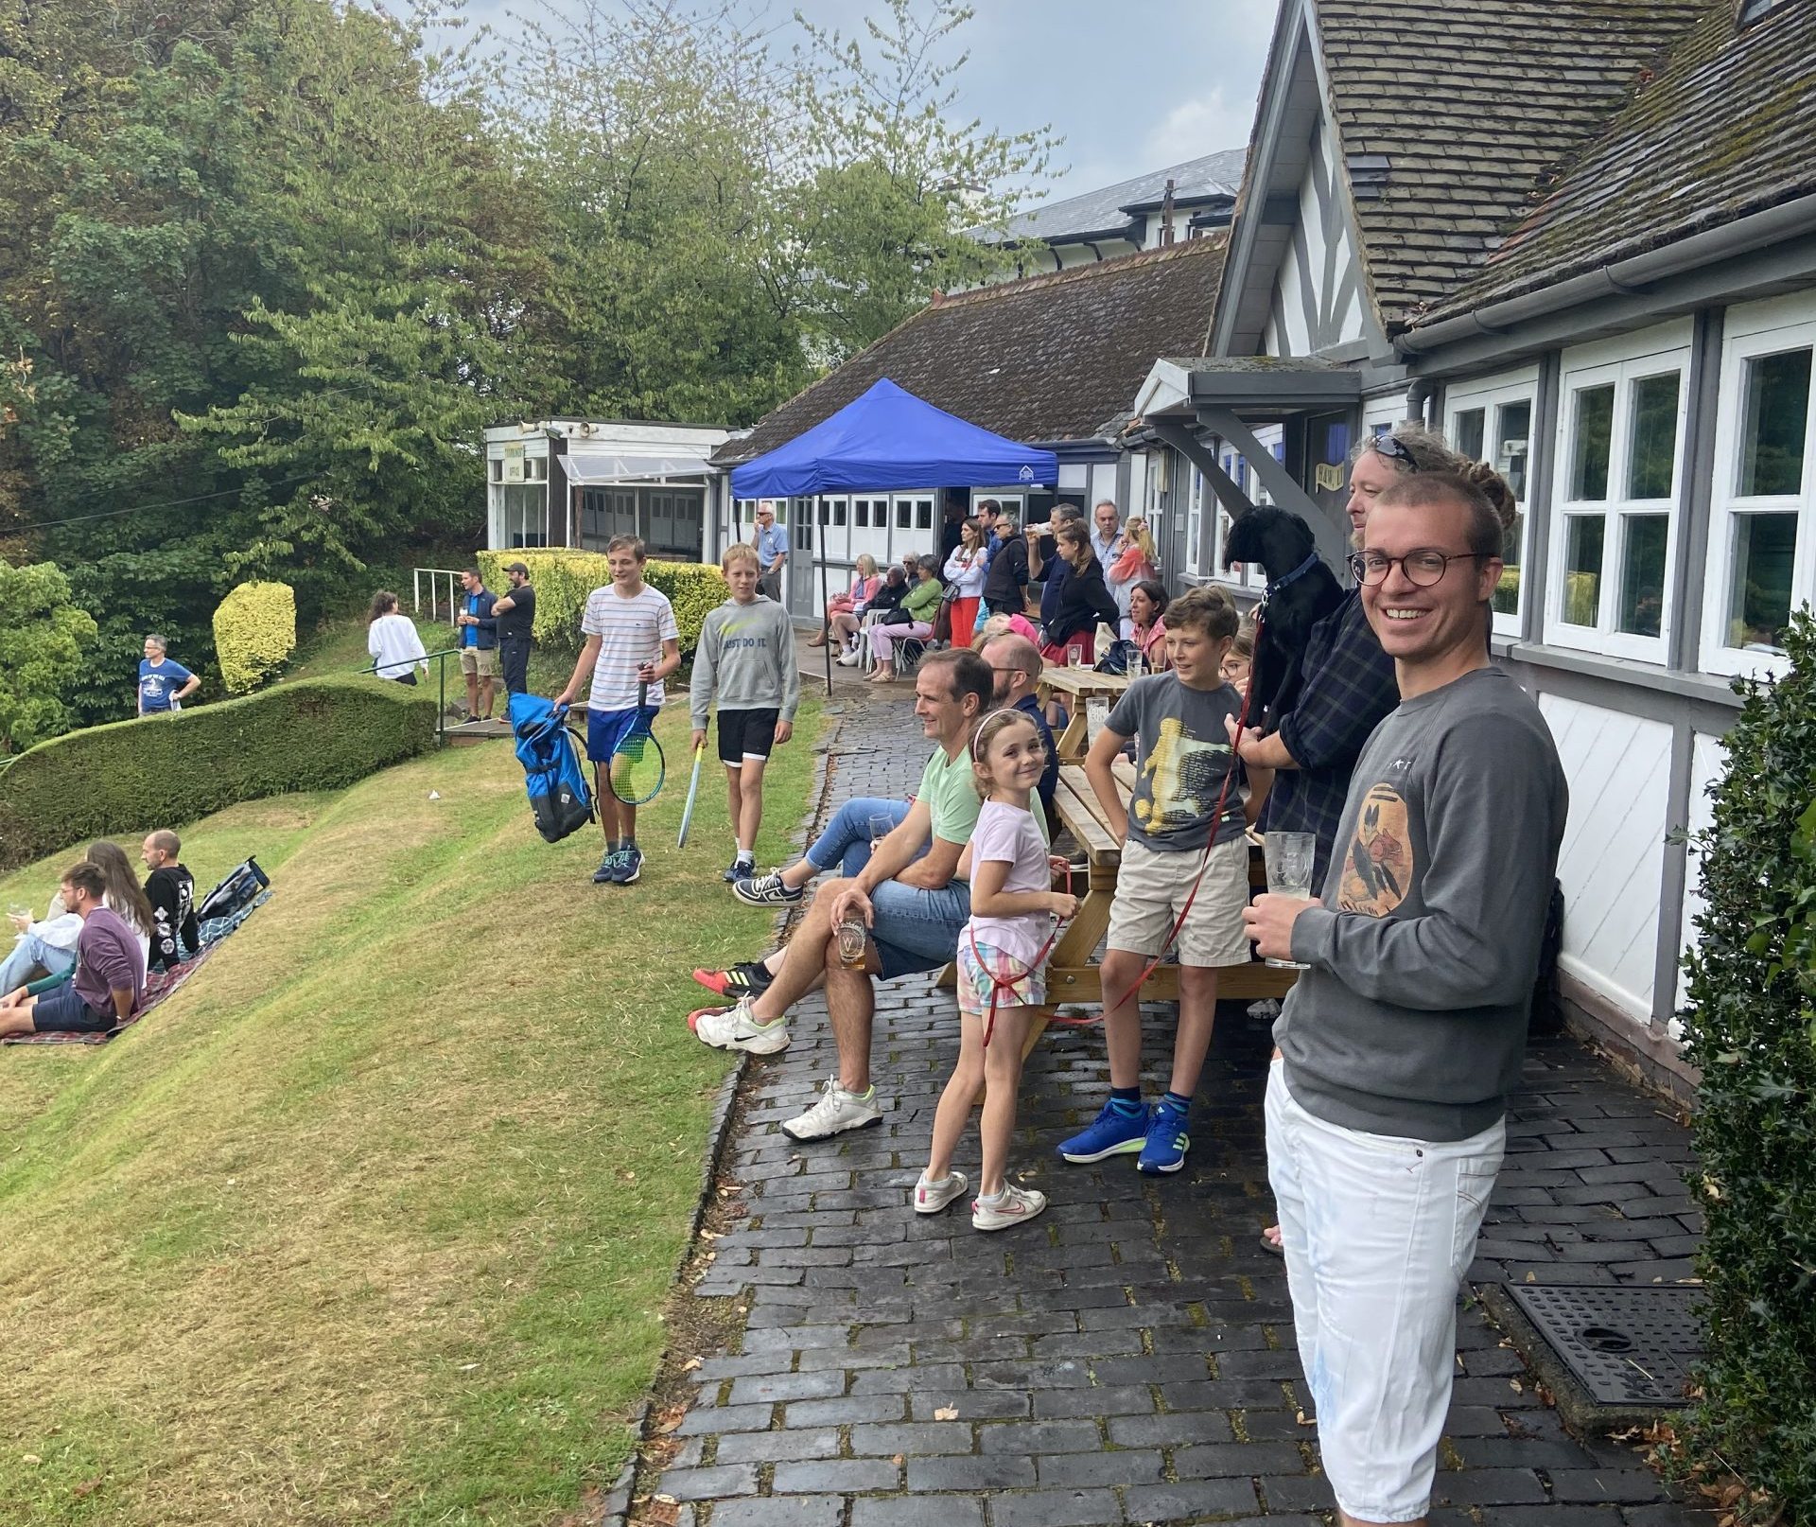
Community Amateur Sports Club
(CASC)
Set up with a formal constitution,
known as a governing document
Open to the whole community and
have affordable membership fees
Organised on an amateur basis
Managed by ‘fit and proper persons’

Slide 19
Summary Preferred Legal Forms
Community Interest Company Limited by Guarantee Large Membership regulated by Companies House
Community Benefit Society regulated by the Financial Conduct Authority
Charitable Community Benefit Society regulated by the FCA and registered with HMRC for tax purposes

Slide 20
Summary Preferred Legal Forms
Charitable Incorporated Organisation Association Model regulated by the Charity Commission
Community Amateur Sports Club with trading arm subsidiary

Slide 21
Questions and Answers
Supporting rural
community-owned
businesses

